Slide 1

Session 5
Tolerance, Dialogue and Cooperation Among the Religious

Slide 2

Learning Outcomes:
to describe the issues related to tolerance inter religious

Slide 3

The Concept of Tolerance
Etymologically, the word tolerance comes from the word tolerare (Latin) which means letting.
In terminology, tolerance means patience to let other people have different opinions , different positions , different goals, different tribes , different religions , and so on
New Webster Dictionary : tolerance is given freedom ( let ) everyone else believes or apply patient in dealing with others .
Tolerance will create a harmonious relationship between humans
This Photo by Unknown Author is licensed under CC BY-SA

Slide 4

Tolerance as the Basic of Inter Religious Cooperation
The Prophets of various religions taught their followers to create peace and unity among mankind.
Tolerance is the basic social ethic of any cooperation between religious adherents.
Without tolerance, there is no cooperation between religious adherents.
Tolerance itself is built on the principles of mutual respect, respect and fairness
This Photo by Unknown Author is licensed under CC BY

Slide 5
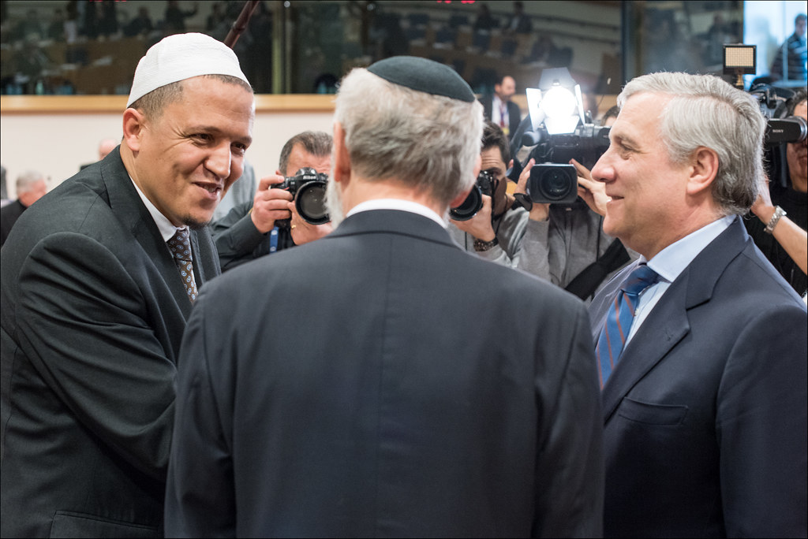
Dialogue between adherents of religions
Dialogue is the best way to achieve mutual trust.
Mutual trust created by dialogue will reduce prejudice among religious adherents.
Thus, dialogue produces social harmony. Religious adherents can coexist even though they are different.
Dialogue can create cooperation between religious adherents
This Photo by Unknown Author is licensed under CC BY-NC-ND

Slide 6
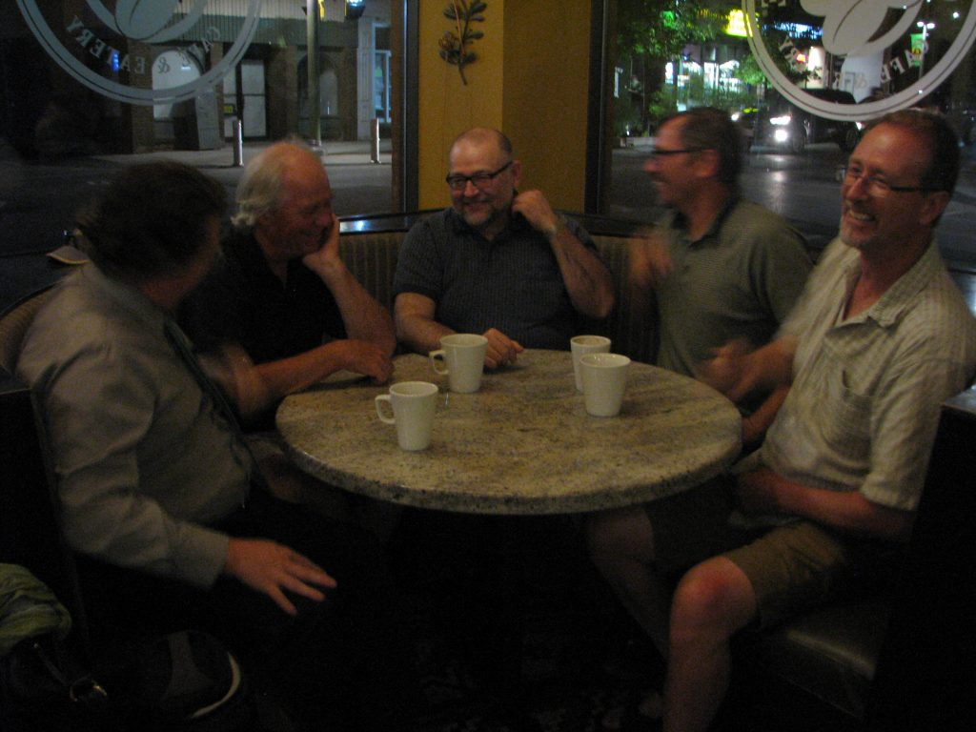
Types of Dialogue Between Religions
Everyday Life Dialogue.
Social Work Dialogue
Spiritual Experience Dialogue
Theological Views Dialogue
This Photo by Unknown Author is licensed under CC BY

Slide 7
References
Tim Penulis CB: Pancasila (2014). Diktat Kuliah Character Building: Pancasila. Binus University: CBDC, 000
Video Jogja: City of tolerance
http://www.youtube.com/watch?v=-EM7gwtw948
Gambar pelangi: images.babynameregistry.info

